Slide 1

TELECOM CUSTOMER CHURN PREDICTION

Slide 2

O U R T E A M
1. Mohamed Ahmed Mohamed Abd - Ellah
2
Habiba Anwar Shafie
Salma Sameh Mahmoud
Ibrahim El - Metwally Abd- Elhamid
Mohamed Samir

Slide 3

AGENDA
Project overview
Dataset
Taken steps overall the project
Models and accuracy comparison

Slide 4



P R O J E C T O V E R V I E W
Exploring a dataset on customer churn for a
telecommunications company and then predict which customers are likely to leave the service based on service-related features.
4

Slide 5








5
BUSINESS IMPACT
MODELS USED
Reducing customer churn can improve revenue and optimize marketing efforts
Logistic Regression
Decision tree
Random forest

Slide 6

A B O U T D A T A S E T
O ve r vi e w
The dataset contains 7,043 customer records with 21 features, including customer demographics ,service-related data and churn status.
C h u r n r a t e
The churn rate is 26.5%, with 5,163 customers not churning and 1,869 customers churning.
6
Ac c u r a c y
The highest accuracy achieved on this dataset is 86.7%

Slide 7

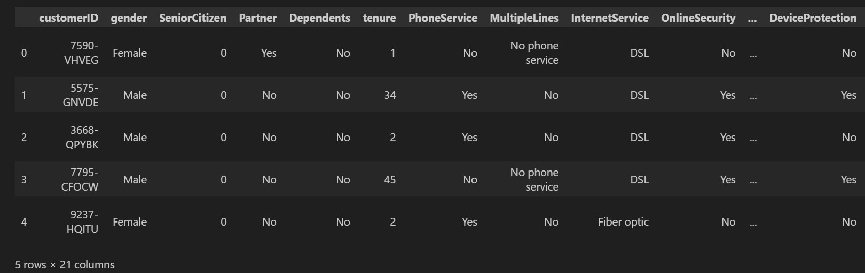

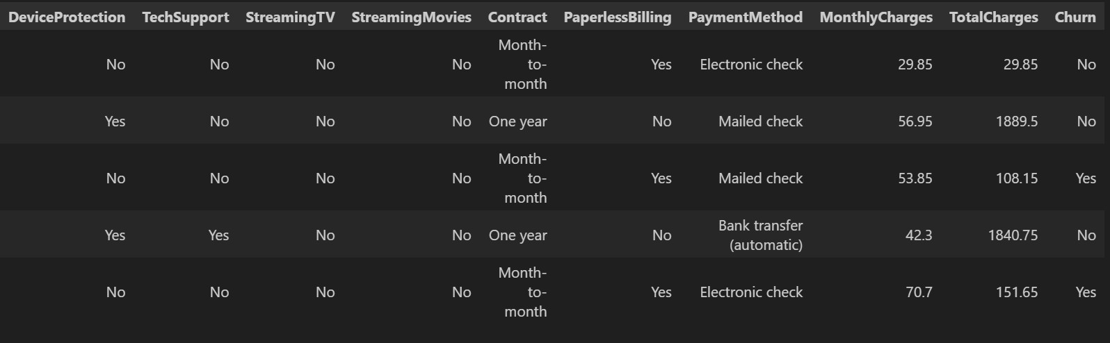
Columns
7

Slide 8

S T E P S
8
EDA
M o d e l i n g Ap p r o a c h
R e s u l t s a n d Ac c u r a c y
Present the performance metrics of the models, comparing accuracy, precision, recall, F1- scores, and roc_auc_score for classification tasks
Show key insights from data exploration and feature engineering. Include visualizations that illustrate trends, or correlations between features
Present the machine learning models used

Slide 9
EXPLORATORY DATA ANALYSIS
(EDA)

Slide 10
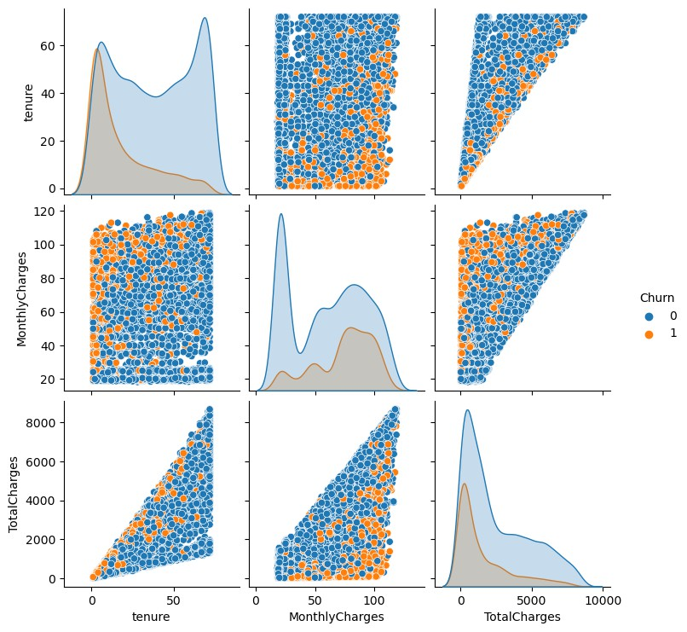
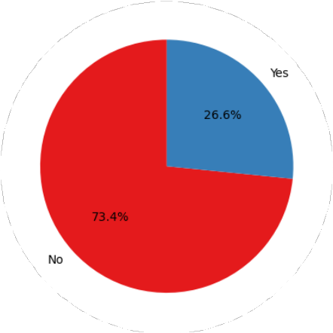
Do basic statistics analysis to get more insights and information about the dataset like data types , duplicates , and missing values .
Check distribution of important features like churn , and the relation between it and other features and visualize the results
R e l a t i o n s h i p s b e t w e e n
n u m e r i c f e a t u r e s a n d c h u r n
C h u r n d i s t r i b u t i o n
10

Slide 11
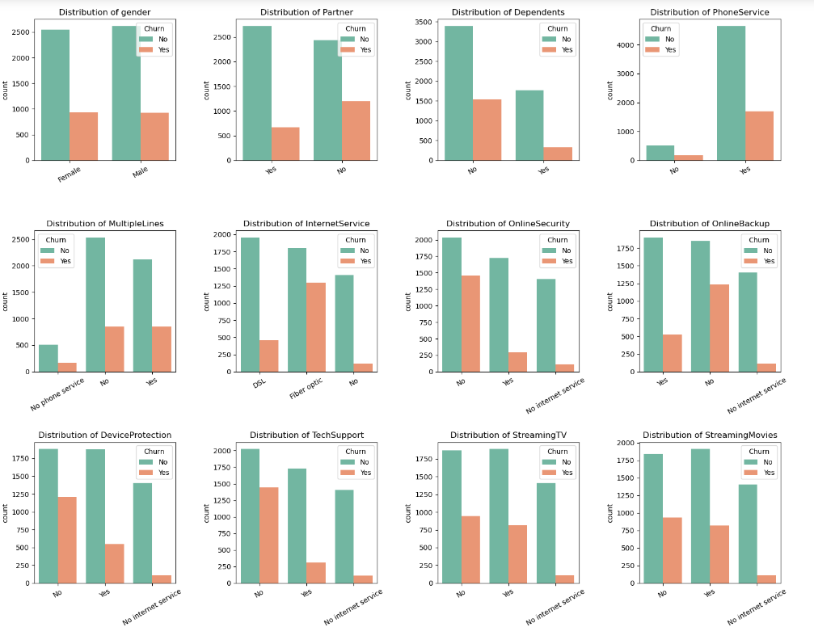
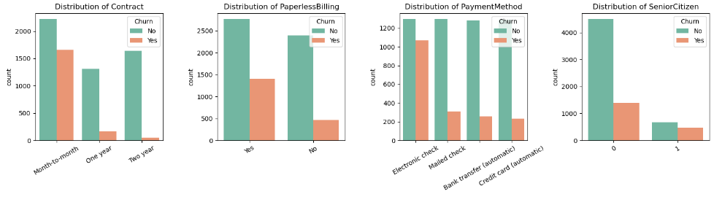
R e l a t i o n s h i p s b e t w e e n categorical f e a t u r e s
Gender: Similar churn rates for both genders.
Partner: Higher churn without partners.
Dependents: More churn without dependents.
Phone Service: Higher churn for those without phone service.
Internet Service: Fiber optic users churn more than DSL users.
Contract: Month-to-month contracts have the highest churn.
Payment Method: Electronic check users churn more.
Senior Citizens: Higher churn for senior citizens.

Slide 12
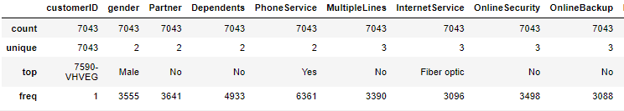
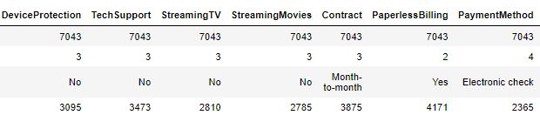
DESCRIPTIVE STATISTICS For Categorical variables
11

Slide 13





F E A T U R E E N G I N E E R I N G
Combined 'Contract' and 'PaymentMethod' into a new feature 'Contract_PaymentInteraction
Created 'TenureGroup' to categorize tenure into groups
Derived 'ChargesPerMonth' from TotalCharges and tenure
12
Added ‘HasPhoneAndInternet’ to indicate customers with both services
Calculated 'NumServices' to represent the total number of services per customer

Slide 14
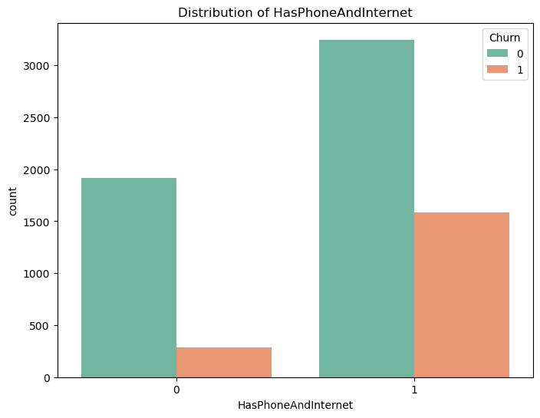
I N S I G H T S O N C H U R N F O R C U S T O M E R S W I T H B O T H P H O N E A N D I N T E R N E T S E R V I C E S
T h e m a j o r i t y o f c u s to m e rs h ave b o t h p h o n e a n d i nte rn et s e r v i c e s .
C u s to m e rs w i t h o u t b o t h s e r v i c e s h ave a l owe r c h u rn
rate .
A m o n g t h o s e w i t h b o t h s e r v i c e s , c h u rn i s h i g h e r, t h o u g h m o s t s t i l l re m a i n l oya l .
13

Slide 15
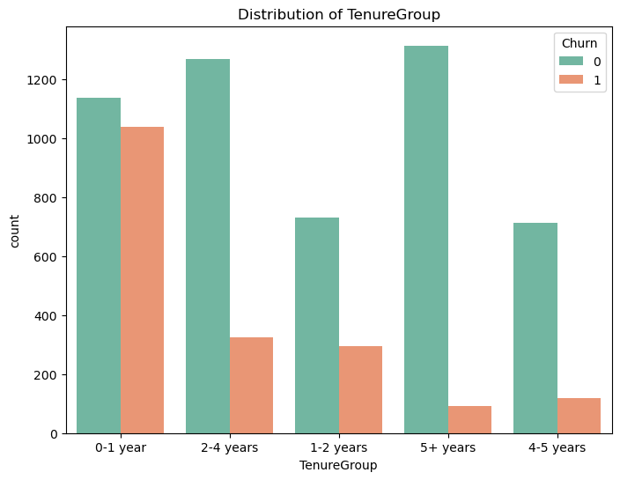
INSIGHTS ON CHURN
B A S E D O N T E N U R E G R O U P
C u s to mers i n t h e 0 - 1 yea r g ro u p s h ow a mu ch
h i g h e r c h u rn rate co m p a re d to o t h e r te n u re g ro u ps .
A s te n u re i n c re a s e s , c h u rn s i g n i f i cant l y
d ecrea s es , w i t h t h e 5 + yea rs g ro u p h av i n g t h e
l owe s t c h u rn rate
14

Slide 16
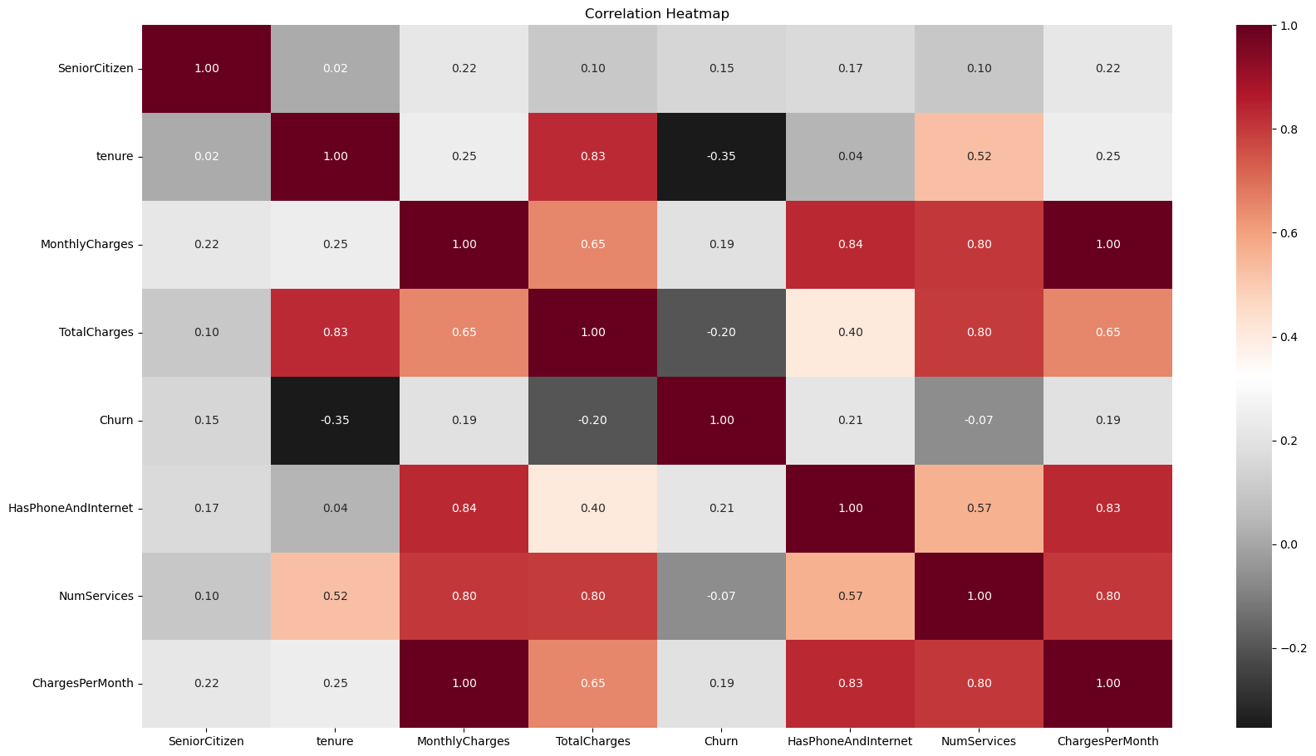
CHECKING FOR CORRELATIONS AND PLOTTING A CORRELATION HEATMAP
A moderate negative correlation exists between churn and tenure, suggesting that customers with longer tenure are less likely to churn.
15

Slide 17

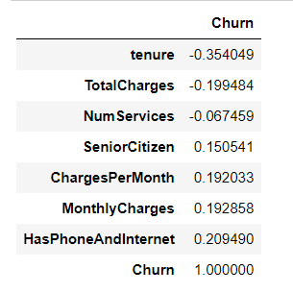
T H E C O R R E L A T I O N V A L U E S B E T W E E N T H E FEATURES AND THE TARGET "CHURN"
Tenure (-0.35): Longer-term customers are less likely to
churn.
TotalCharges (-0.20): Higher total spend lowers churn risk.
HasPhoneAndInternet (0.21) and MonthlyCharges (0.19): Higher churn risk for customers with bundled services or higher bills.
SeniorCitizen (0.15): Slightly higher churn among senior
citizens.
16

Slide 18
D A T A P R E P R O C E S S I N G
M I S S ING V AL U E S
Checked for missing values and found a small
percentage so it was removed (totalCharges) column
D A T A E N C O D I N G
Encode categorical variables :
Binary variables using LabelEncoder
Multi-class variables using one-hot
encoding
T YPE C O NV E R S IO N
17
Converted some columns into the correct type (numeric) to use it easily
I M B AL ANC E D AT A
Addressed class imbalance using SMOTE and Tomek Links
By making the data balanced we can achieve high accuracy

Slide 19

MODELS'
IMPLEMENTATION

Slide 20
U S E D M O D E L S A N D
B E N E F I T O F E A C H O N E
19
L O G I S T IC
R E G R E S S I O N
D E C I S I O N T R E E
R AND O M
F O R E S T
Simple, easy to interpret, and works well for linearly separable data. Useful for understanding the influence of individual features on churn probability
Captures non-linear relationships and provides easily interpretable
rules.
Handles categorical data naturally
Reduces overfitting by combining multiple decision trees and improves accuracy, especially for imbalanced
datasets.
Works well with both continuous and
categorical features.

Slide 21
A C C U R A C Y C O M P A R I S O N
86.202%
86.000%
85.305%
20
84.000%
82.000%
81.076%
80.000%
Random Forest
logistic regression
Decision Tree

Slide 22
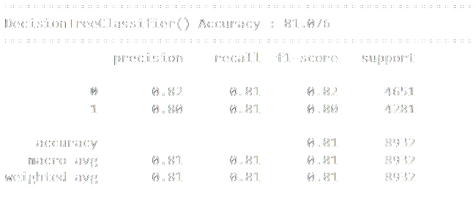
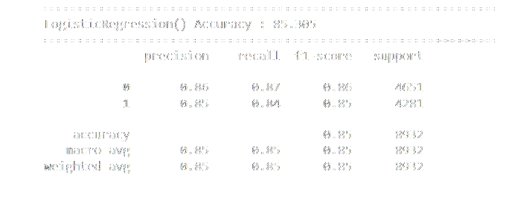
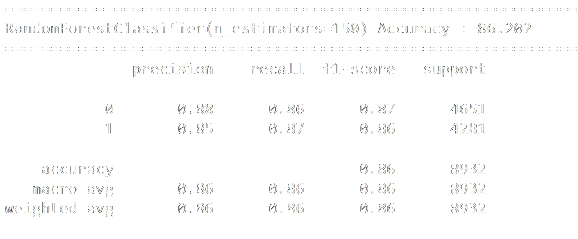
C O N F U S I O N M A T R I X R E P O R T

Slide 23
While all three models performed well, the
Random Forest model showed slightly superior
accuracy and ROC AUC scores with cross-validation
22
approach. This suggests that it may be the
preferred model for predicting customer churn in this dataset

Slide 24

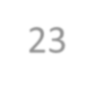
THANK YOU
23

